Slide 1
Predicting
21/02/2024
Year 7 Science

Slide 2
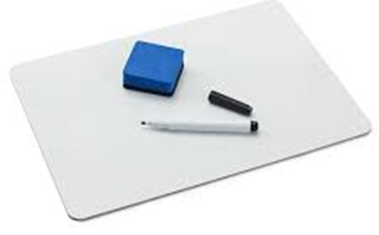
Review: Observation or inference
The sky is blue.
The weather is nice.
The bin is full.
Someone forgot to empty the bin.
The student is wearing a green shirt
The grass is wet
It must have rained
There must be someone at the door
There is a knocking sound at the door
The temperature is 35ºC

Slide 3
Learning Intentions
Identify questions and problems that can be investigated scientifically and make predictions based on scientific knowledge

Slide 4
Success criteria
Make predictions
Identify types of variables
Record data in a table
Make a graph

Slide 5
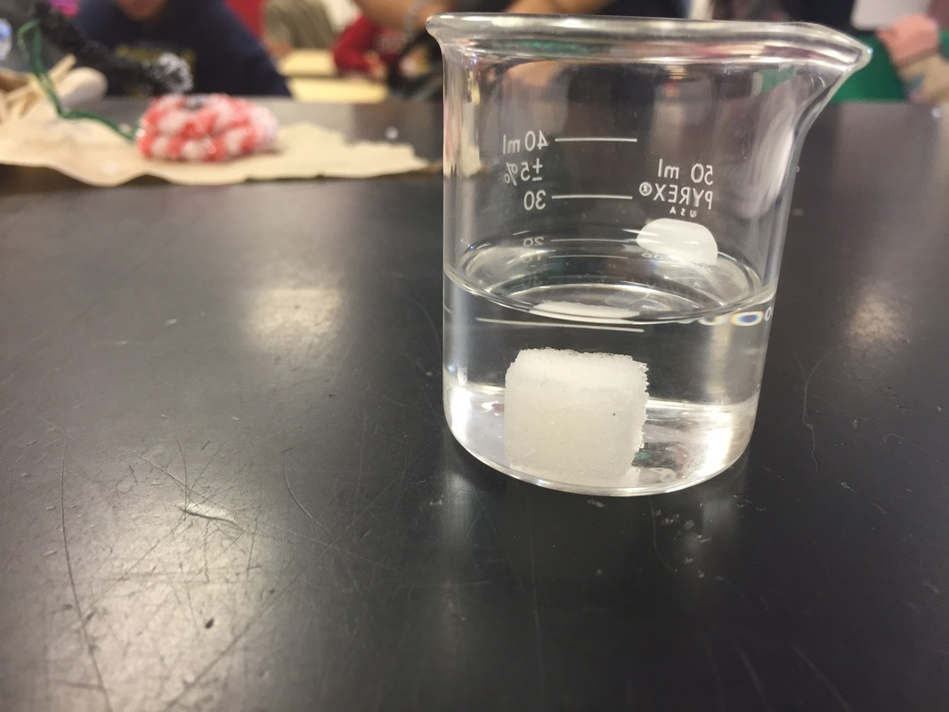
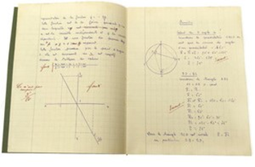
Observing and Predicting
Observe (before)
Predict
Observe again (later)

Slide 6
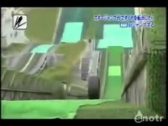

Slide 7
Success criteria
Make observations and predictions
Record data in a table
(Make a graph)

Slide 8
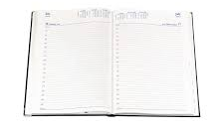
Homework sheet – reading scales
Due Monday 19 Feb

